Slide 1
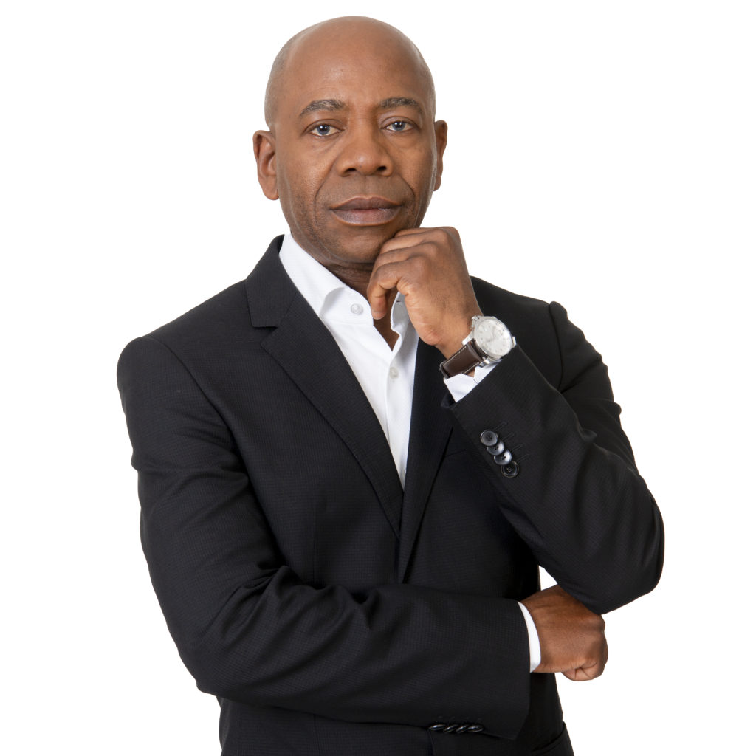
e’Bosch - Stellenbosch University Annual Heritage Lecture
Theme: The future heritage of business in South Africa
Guest Speaker: Prof. Bonang Mohale
Date: 23 September 2021
Time: 18:00pm – 19:30pm
Platform: MS Teams

